Slide 1

POORNIMA
COLLEGE OF ENGINEERING
INSTANT ELECTRONIC SERVICE [IES]
Submitted By :--
Khushal Mittal
Lakshya Khandelwal
Mohit Kumar Singh
Krishna Soni
Kartik Sharma
Submitted To :--
Mrs. Deepika Agarwal

Slide 2


Slide 3
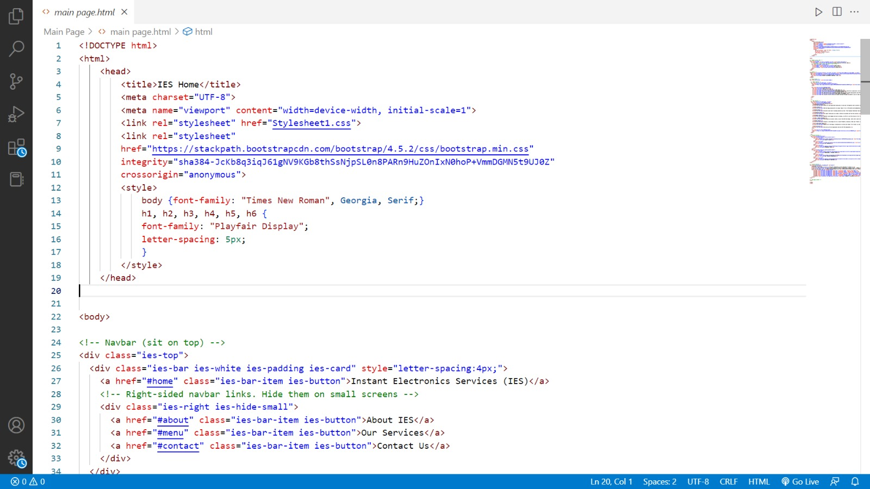

Slide 4
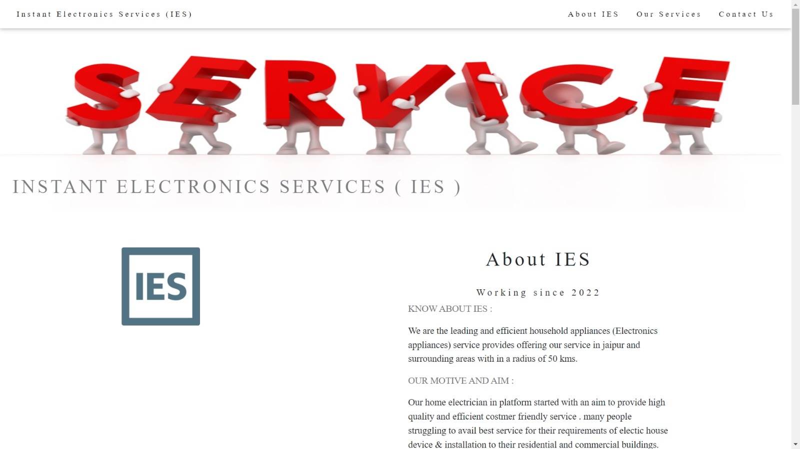

Slide 5
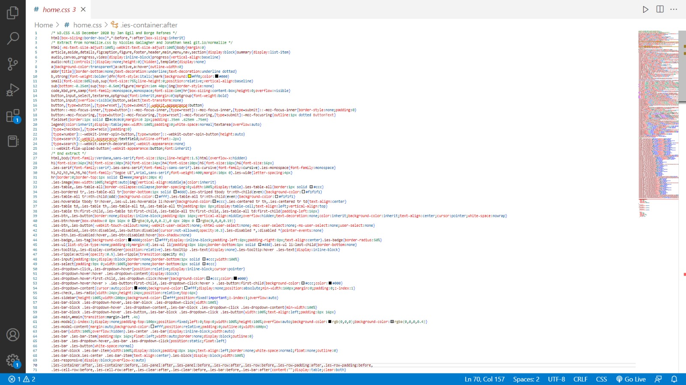

Slide 6


Slide 7
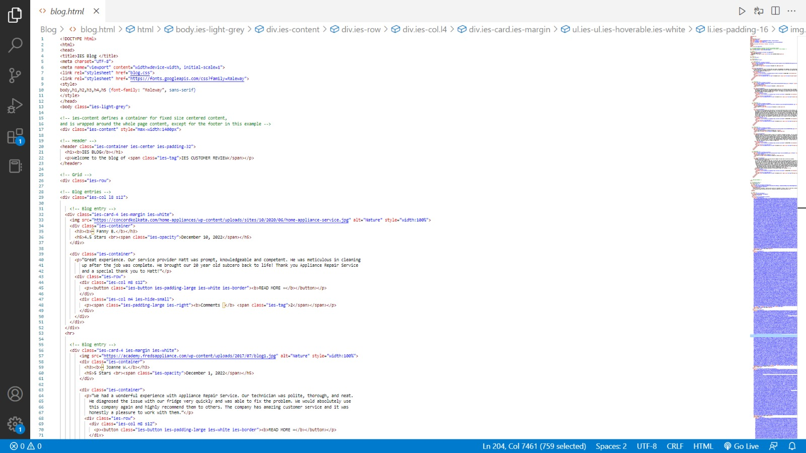

Slide 8
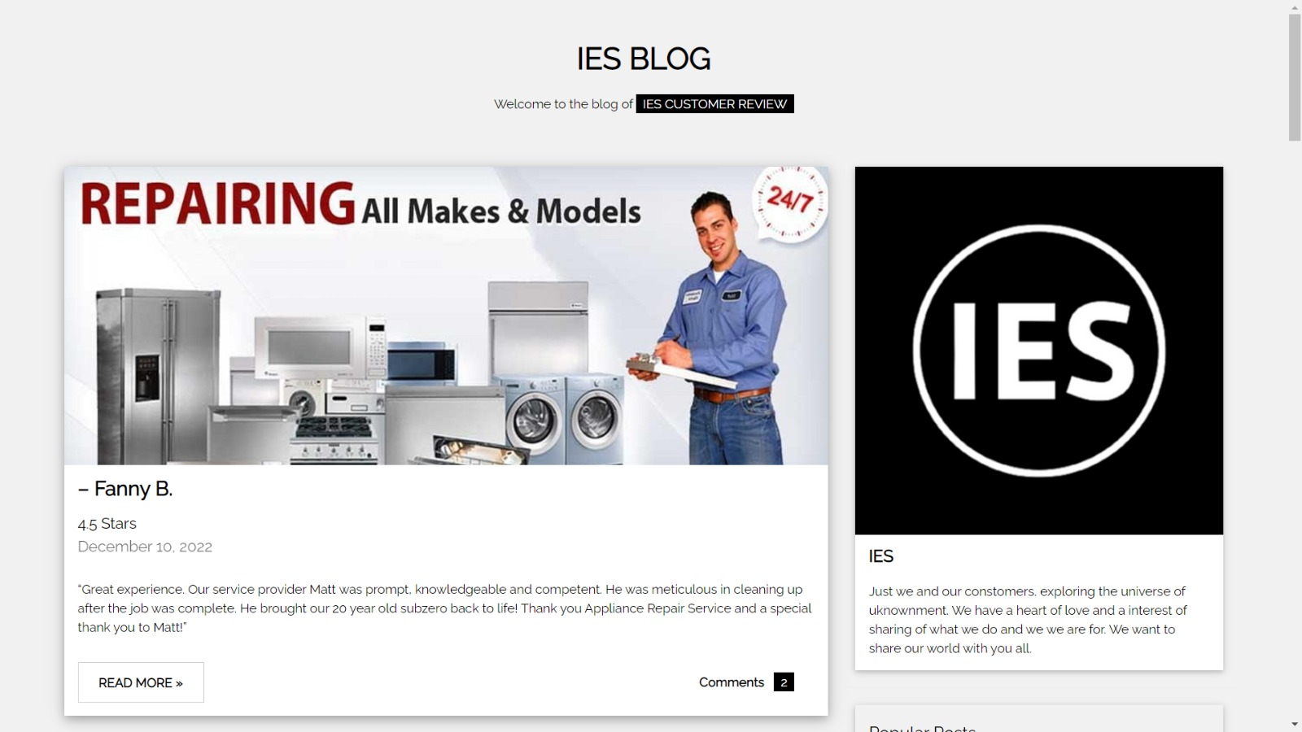

Slide 9
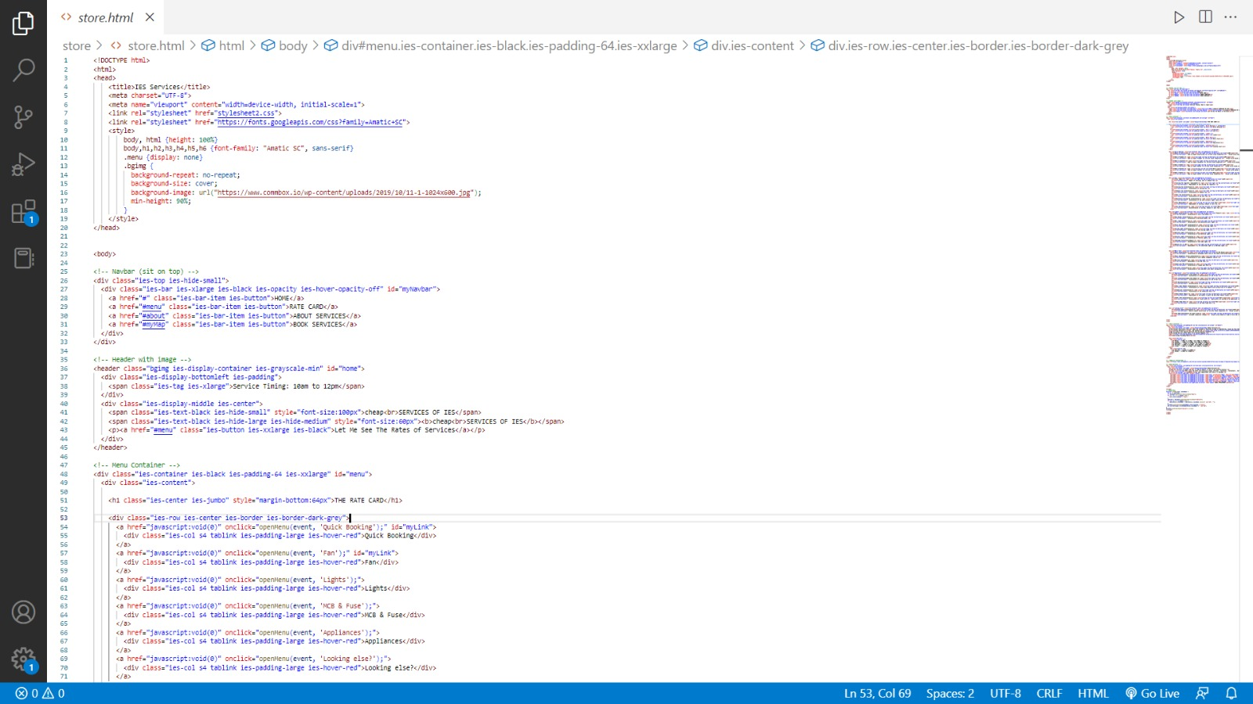

Slide 10
THANK YOU

